Slide 1

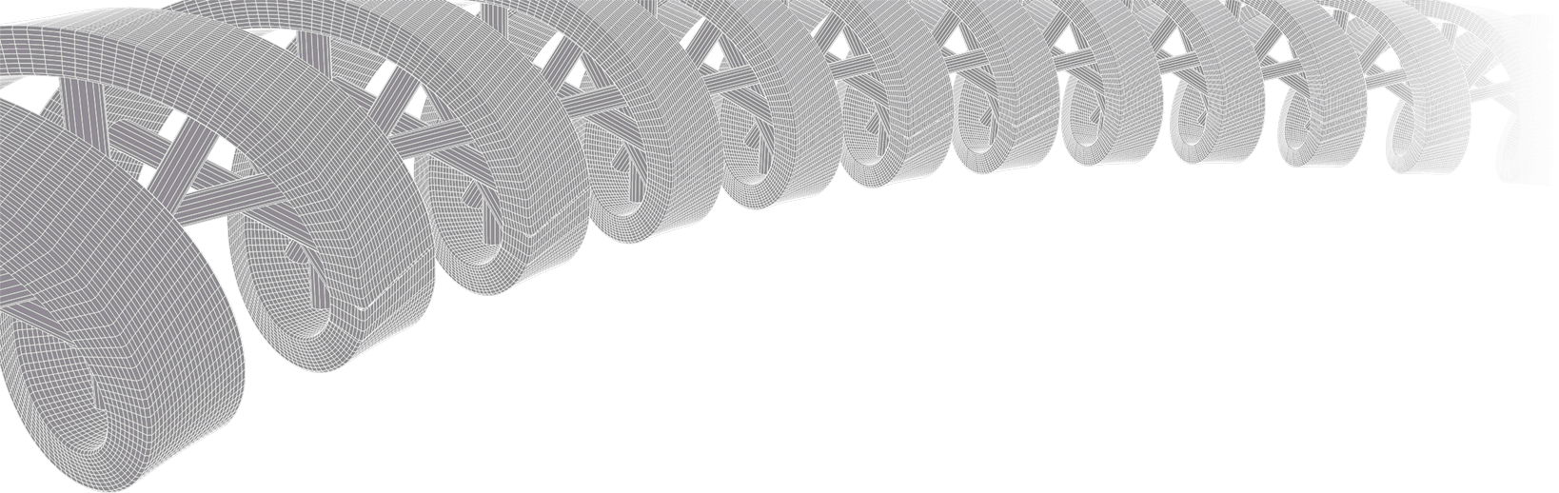
Genomic data visualization and interpretation
Malachi Griffith, Zachary Skidmore, Obi Griffith
Workshop on Genomics
May 27, 2022
Český Krumlov, Czech Republic

Slide 2
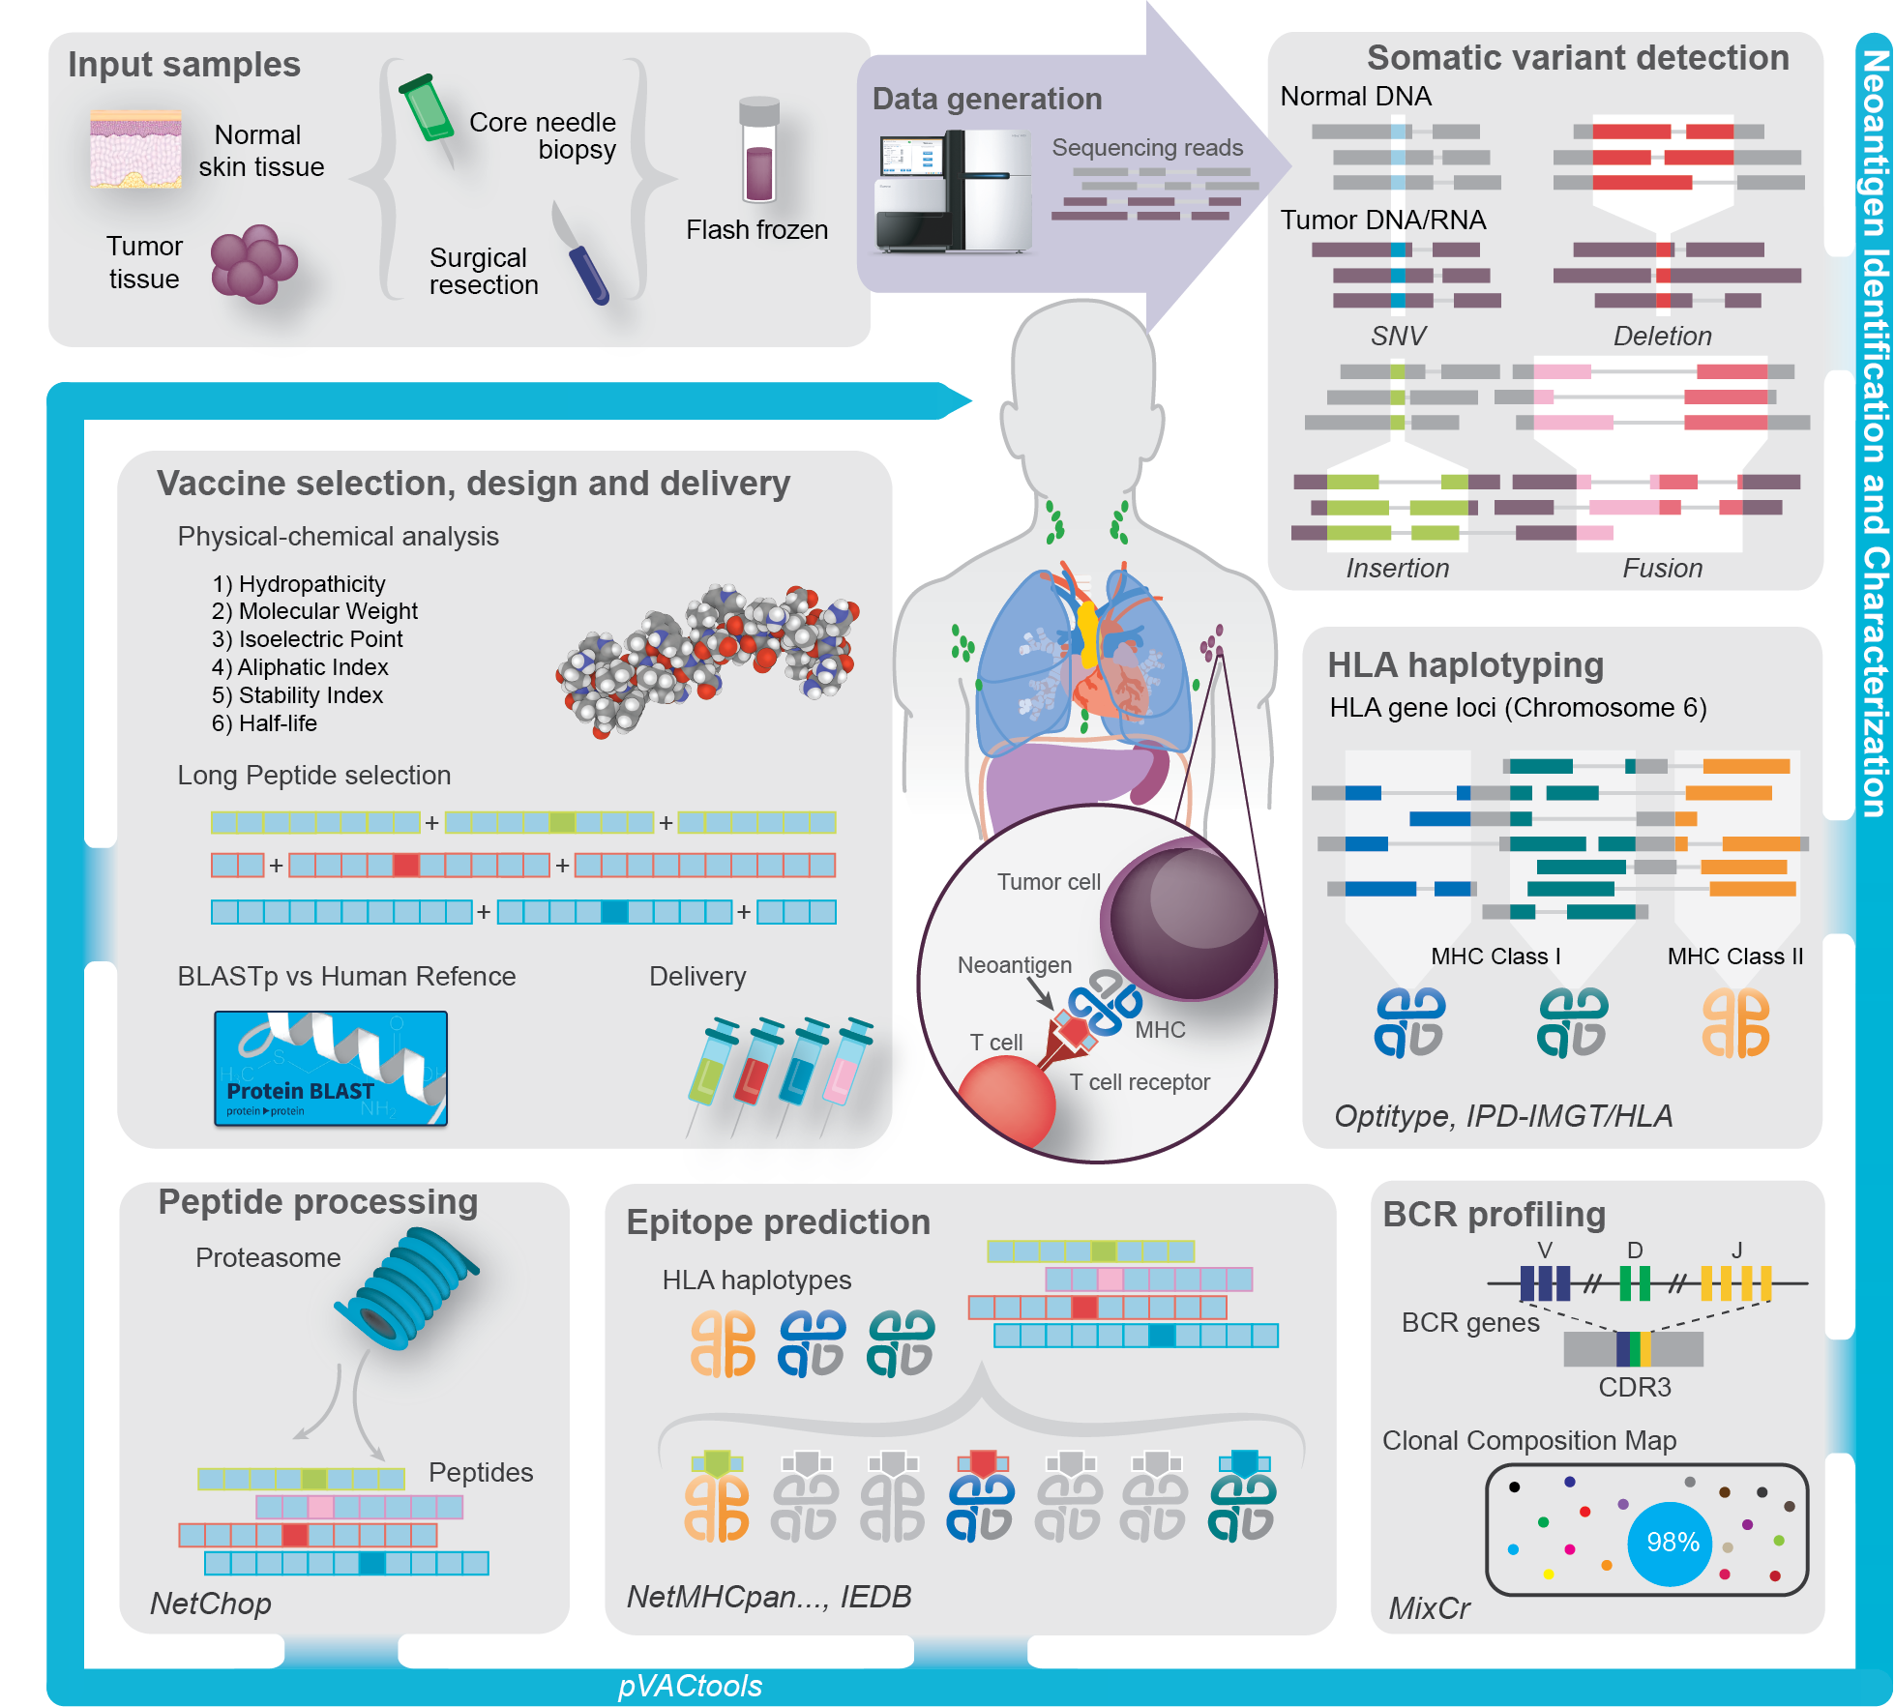
My background: Translational genomics and personalized oncology
griffithlab.org

Slide 3
Why do we create visualizations of genomic data?
Data exploration and interpretation of results
QC analysis
Understanding whether/how an experiment worked
Discovery
Communication
Slides for presentations
Figures for publications

Slide 4
Fundamentals of data visualization

Slide 5
Fundamentals of data visualization
Where to learn more about the art and science of visualization:
Collection of 40 Nature Methods articles on data visualization: “Points of View” Articles
Visual design principles lecture

Slide 6
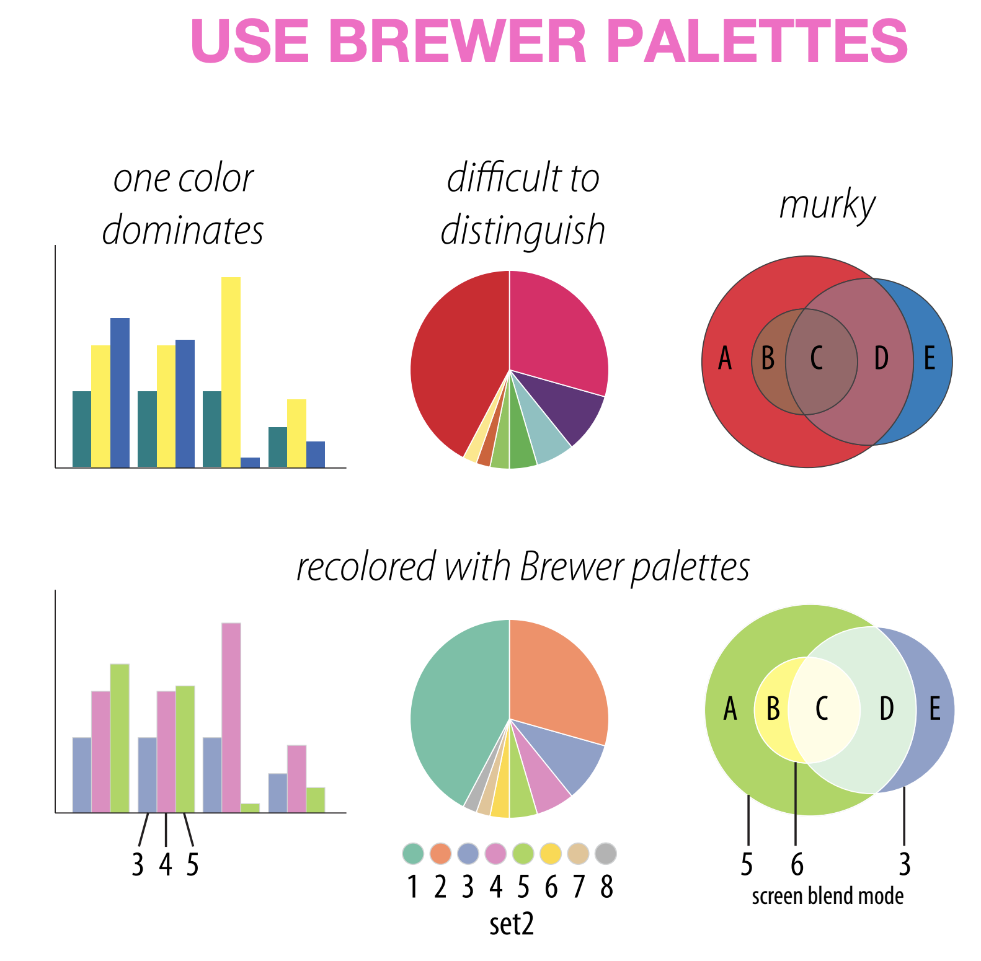
Which series is more effective (top or bottom)?
Martin Krzywinski

Slide 7
Which series is more effective (top or bottom)?
Martin Krzywinski

Slide 8
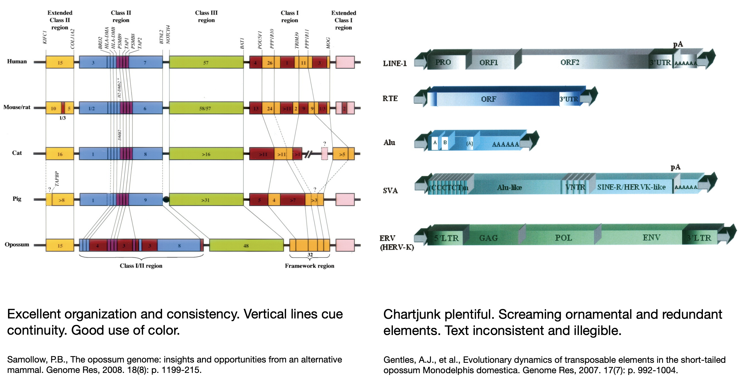
Which is more effective (left or right?)
Martin Krzywinski

Slide 9
Which is more effective (left or right?)
Martin Krzywinski

Slide 10
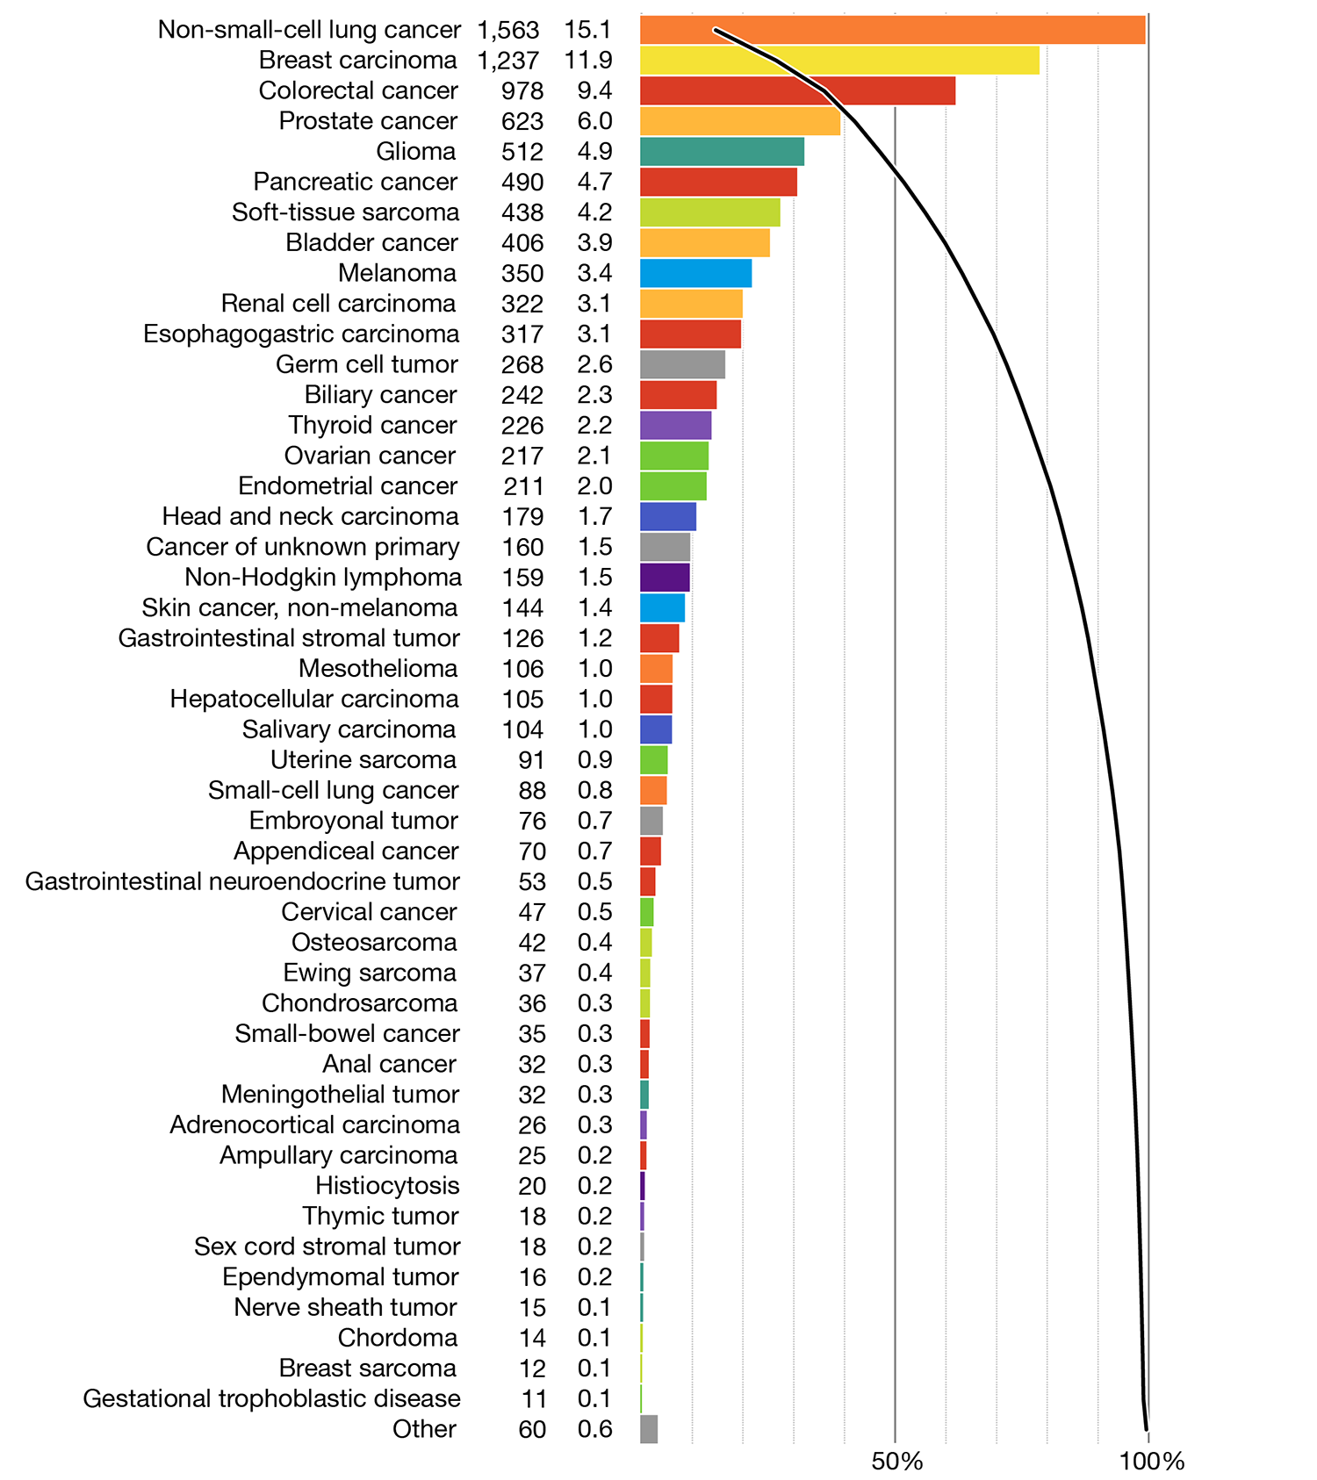
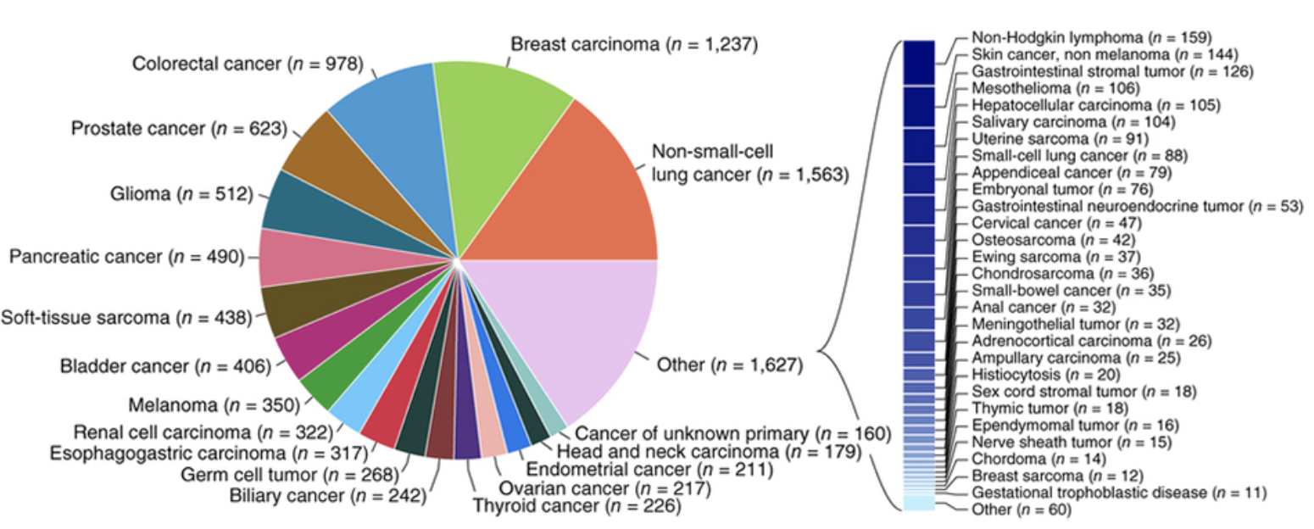
Which is more effective (left or right?)
Martin Krzywinski

Slide 11
When to not use a pie chart
Ahmet Zehir et al. (2017) Nature Medicine doi:10.1038/nm.4333
Hard to judge proportions
Poor use of color
Hard to read labels
Over ½ of the categories had to broken out of the pie chart
Martin Krzywinski

Slide 12
Same data with a redesigned approach
Martin Krzywinski
Notes:
Note the use of colors that are easy to distinguish from one another.
Now all data is displayed in the same way
Now we have bot the absolute numbers of cases, and the proportions of total listed on the left
Now we are able to show them in descending order. Instead of searching and parsing the relative size of the pie slices.
Finally, note the overlaid line that we can use to assess the cumulative proportion of all cases represented by the top N categories.

Slide 13
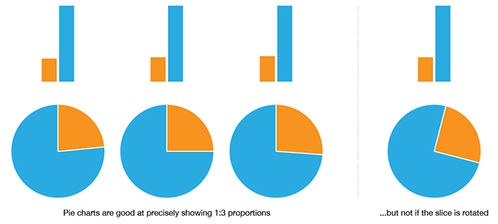
When to use a pie chart
Martin Krzywinski
Notes:
The pie chart is more intuitive than a bar plot when you have two numbers in a 1:3 proportion. Even then, it only works well when the slice is aligned. Basically if your data is more complex than this, the pie chart starts to suck pretty quickly.

Slide 14
Selected articles on fundamentals of data viz
Visualizing samples with box plots
Circos plots
When to use (and not use) pie charts
Resources for choosing colors
http://colorbrewer2.org/
http://mkweb.bcgsc.ca/color/
Understanding and using Color Palettes
Color palettes for color blindness
Names for >9000 colors
Including 40 beer colors
Credit to Martin Krzywinski for his extensive work in this area and many of the above resources

Slide 15
Best practices in visualization

Slide 16
Best practices from this workshop
*Always* label axes
Consider readability of font size
Avoid vertical or angled text if possible
Avoid unnecessary use of color, point shapes, etc.
Chose colors wisely
If individual data points are being plotted and have started to really pile up on top of each other consider using a density function
Always be transparent about what data manipulation is taking place (e.g. log scale, filtering of outliers, etc.)

Slide 17
Best practices from the experts
Ten Simple Rules for Better Figures (Rougier et al. 2014):
Scientific visualizations should act as a “a graphical interface between people and data”. Try to follow these rules.
Know Your Audience
Identify Your Message
Adapt the Figure to the Support Medium
Captions Are Not Optional
Do Not Trust the Defaults
Use Color Effectively
Do Not Mislead the Reader
Avoid “Chartjunk”
Message Trumps Beauty
Get the Right Tool

Slide 18
Example visualizations using R

Slide 19
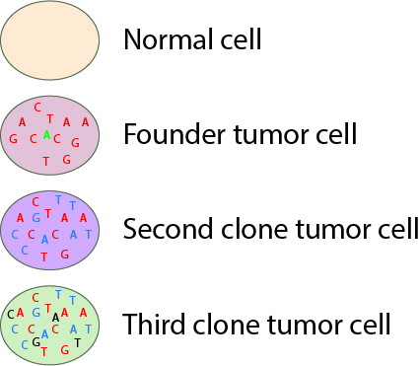
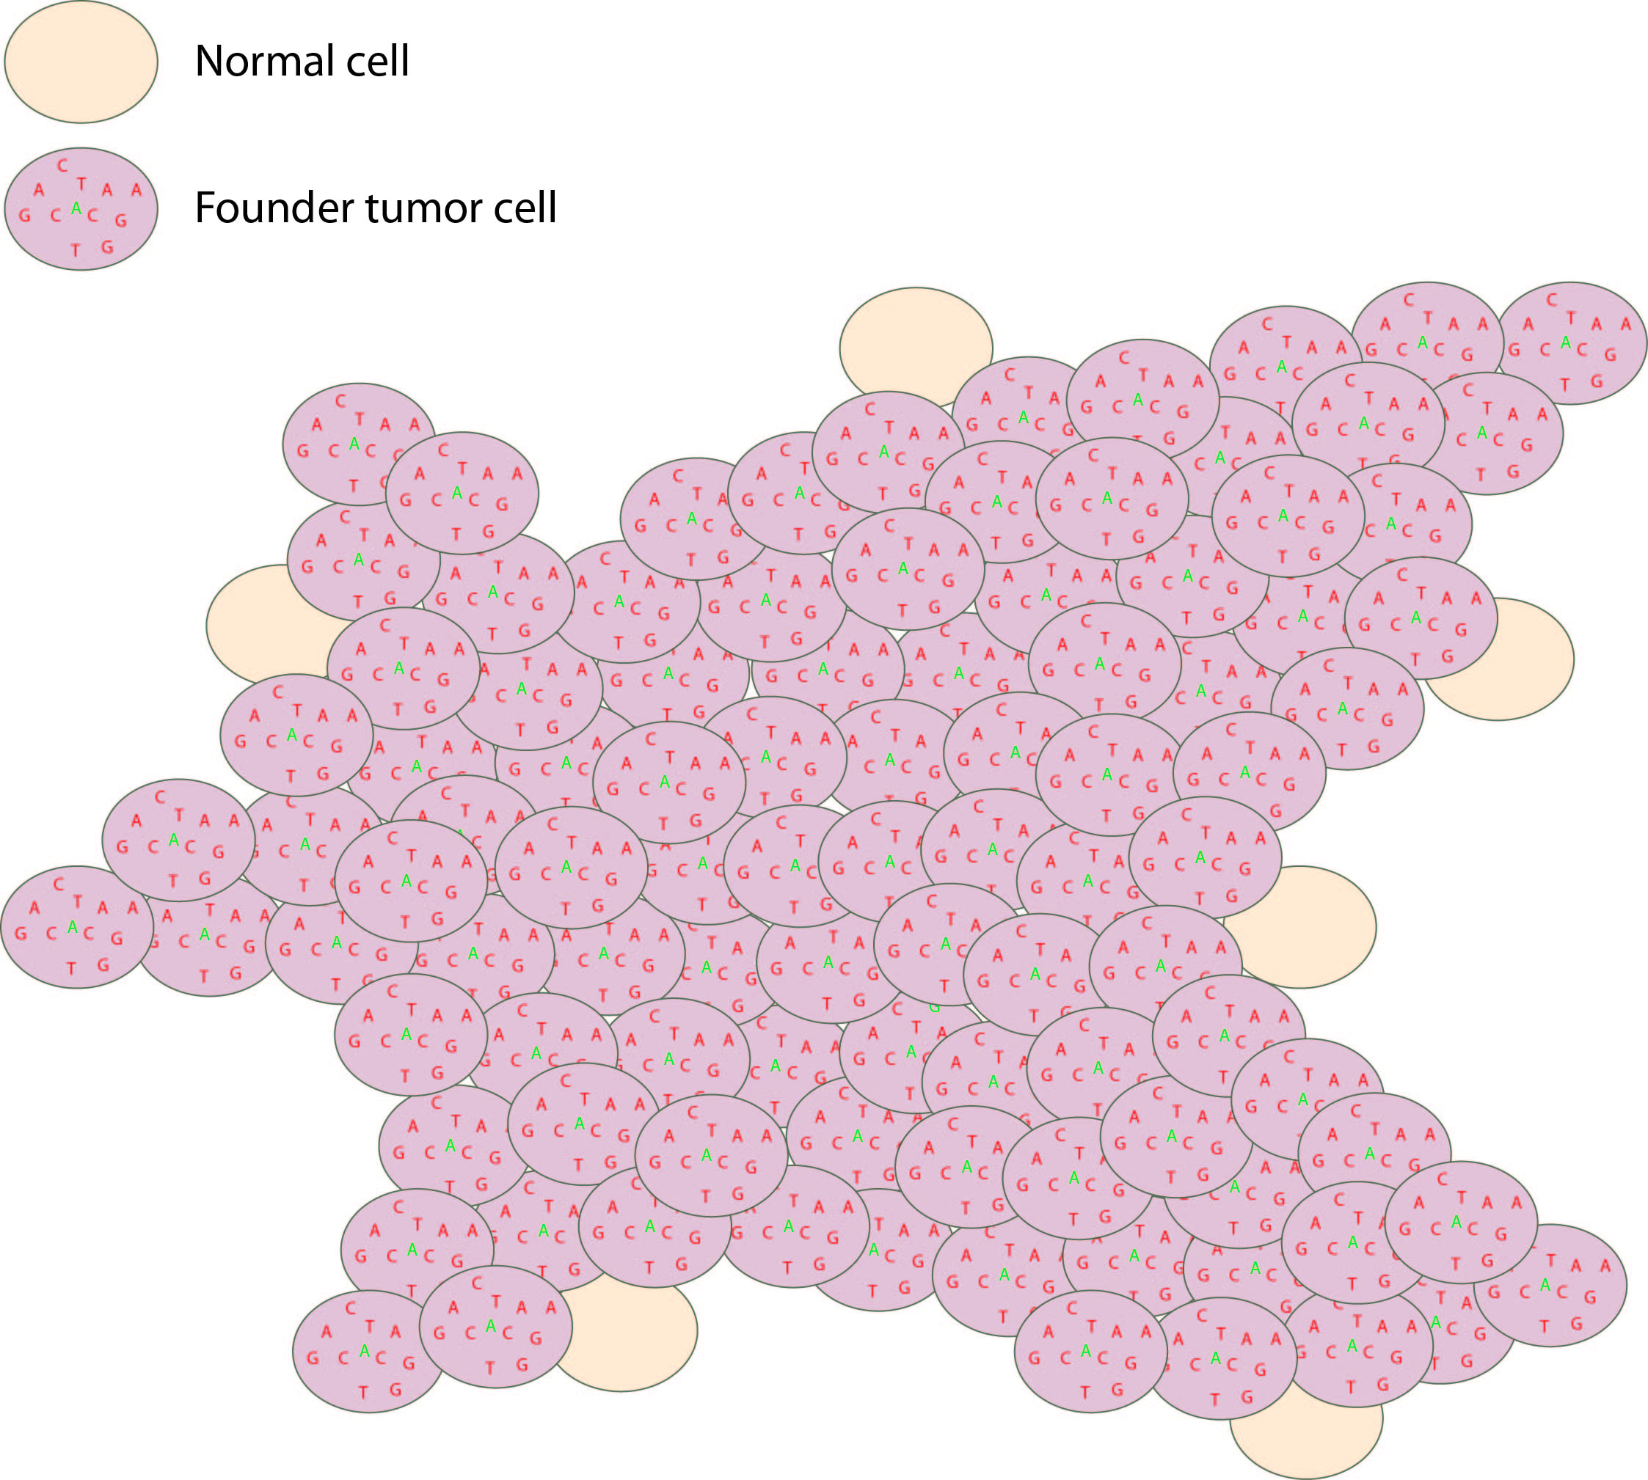
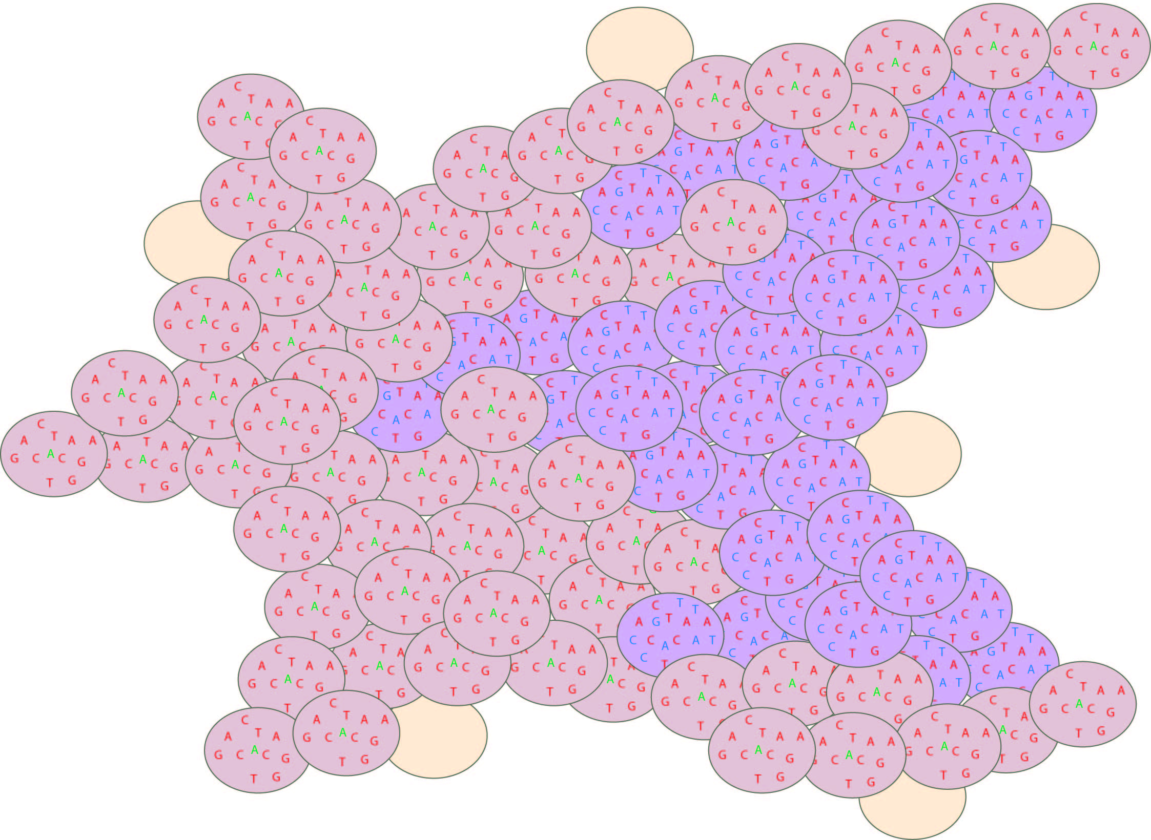
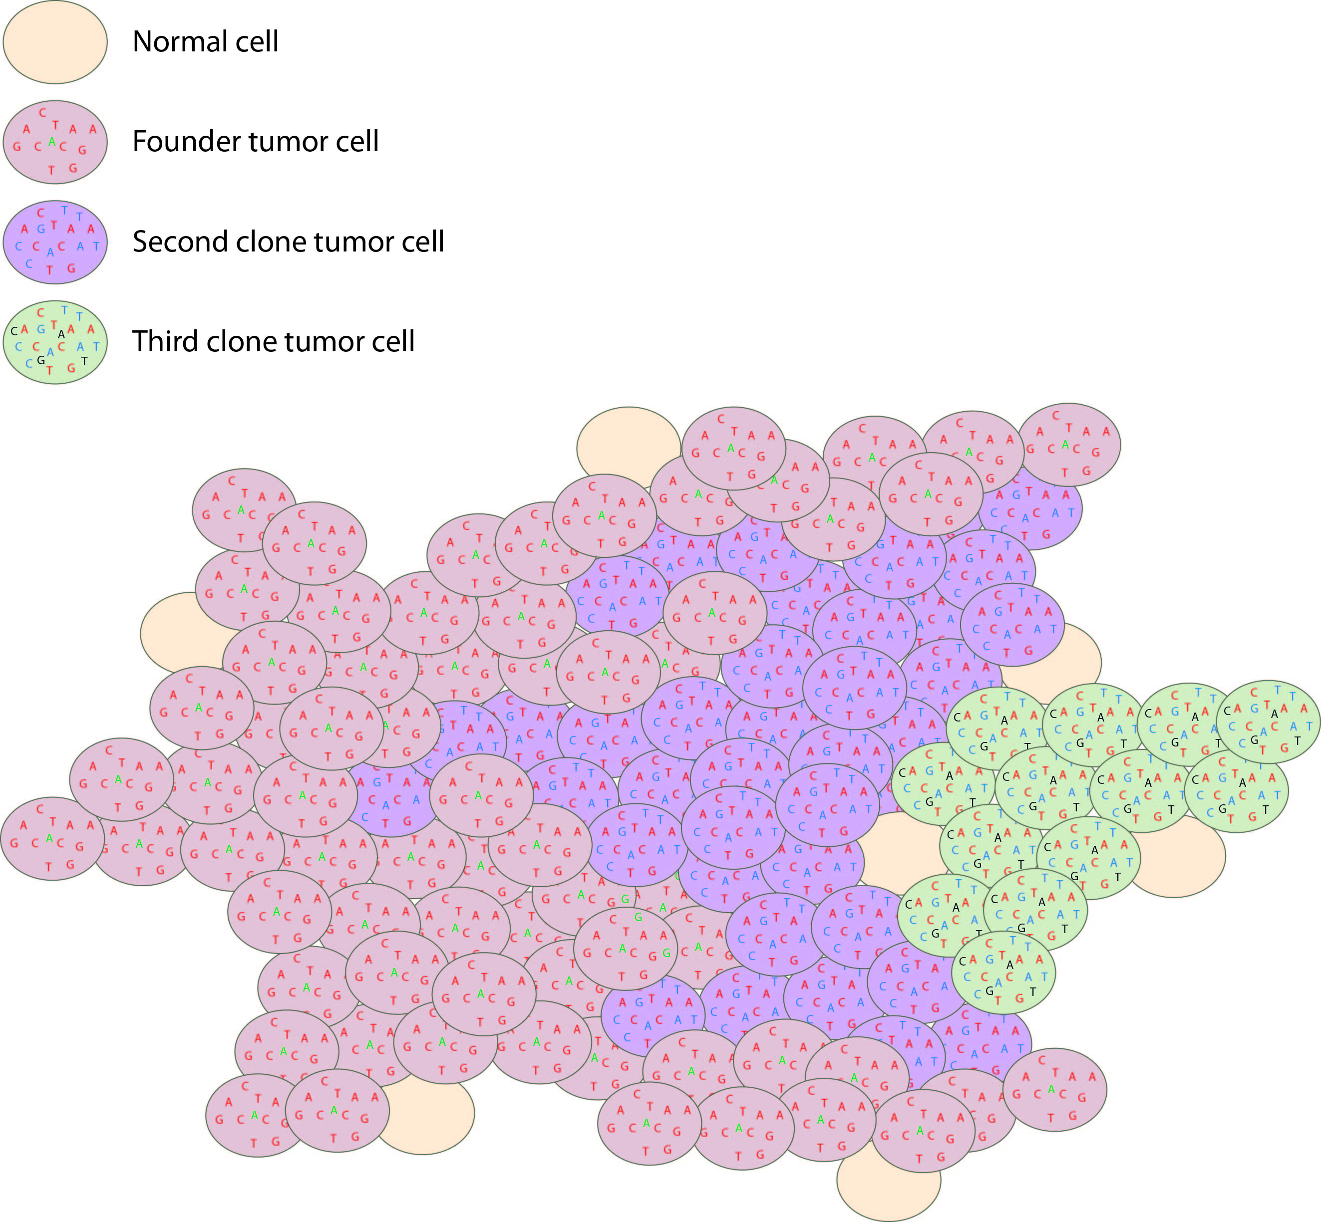
Visualizing tumor evolution
Tumor initiation
Unknown time
1.5 years
Primary tumor
(at diagnosis)
Recurrence

Slide 20
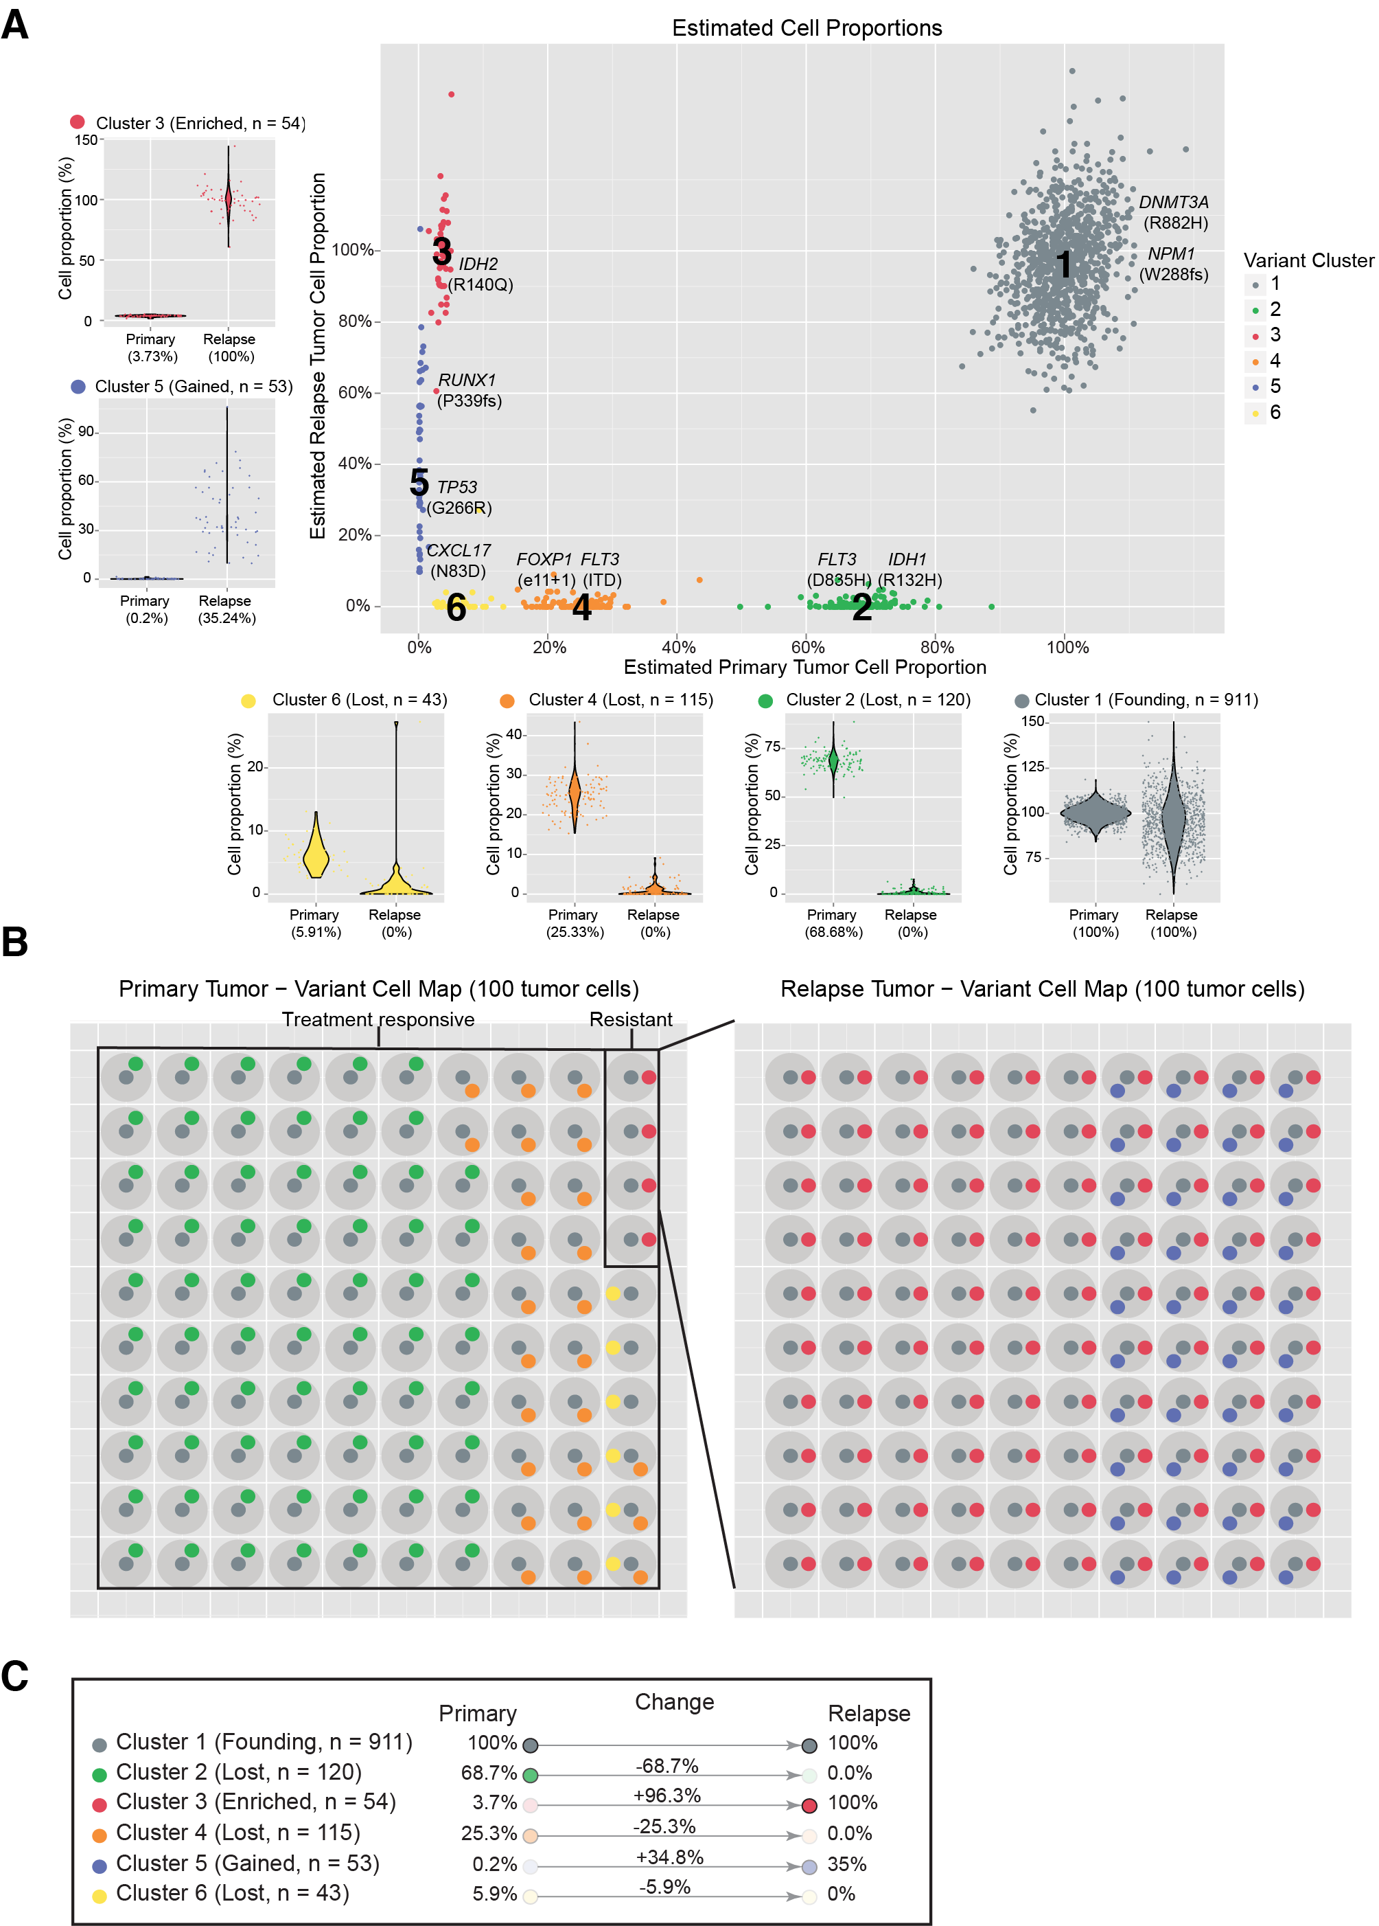
Clustering VAFs to define to distinct cell populations
Notes:
If we overlay each of these mutations on the rest of the platinum variants and use a clonality inference tools like SciClone we can resolve 6 different sub-clones, each with a couple driver mutations present. Except sub-clone 6. Based on our experiences so far we probably still haven’t sequenced deeply enough to find a driver event in that sub-clone yet.
You can see how in each of the surrounding plots, a shift in VAF distribution is occurring between primary and relapse.

Slide 21
Using a “cell map” to represent the variant clusters in 100 hypothetical cells of a tissue

Slide 22
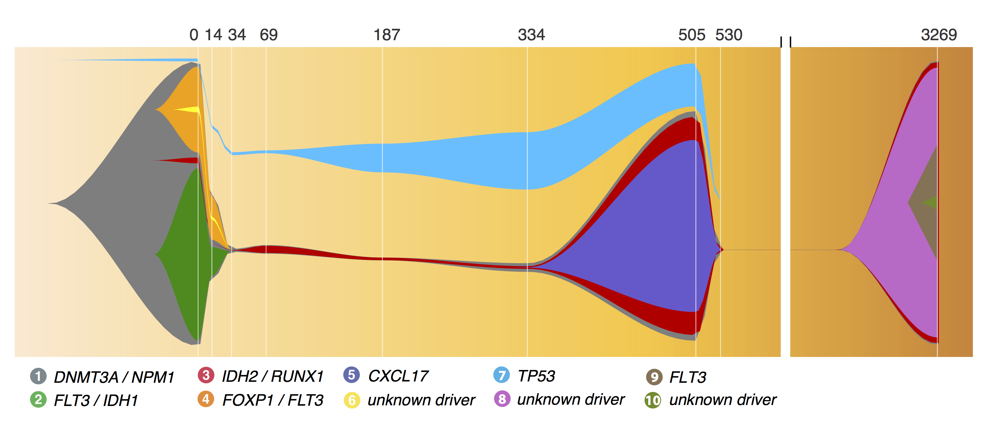
A ‘fish’ plot is used to represent sub-clones lost and gained over time

Slide 23
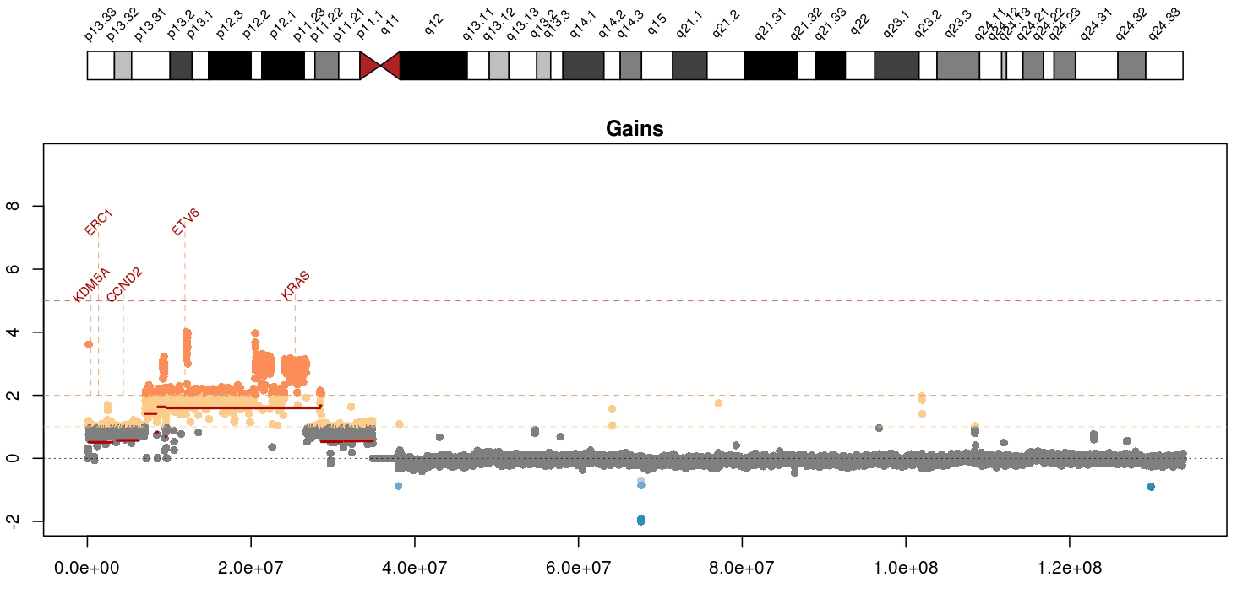
Visualizing copy number variation
Mean tumor-normal depth per 10kb window plotted
KRAS amplification in a metastatic breast cancer
Notes:
Whole genome data is exceptionally good a detecting copy number alterations in tumors. You essentially get a beautiful digital karyotype for each tumor. Here we see a complex amplification affecting KRAS and ETV6 and other critical cancer genes by both single copy and two copy gains.
We currently use cnv-hmm, CopyCat, and CnView for this kind of copy number analysis

Slide 24
A ‘waterfall’ plot is one way to visualize the pattern of variant recurrence in a cohort of samples
https://github.com/griffithlab/GenVisR

Slide 25
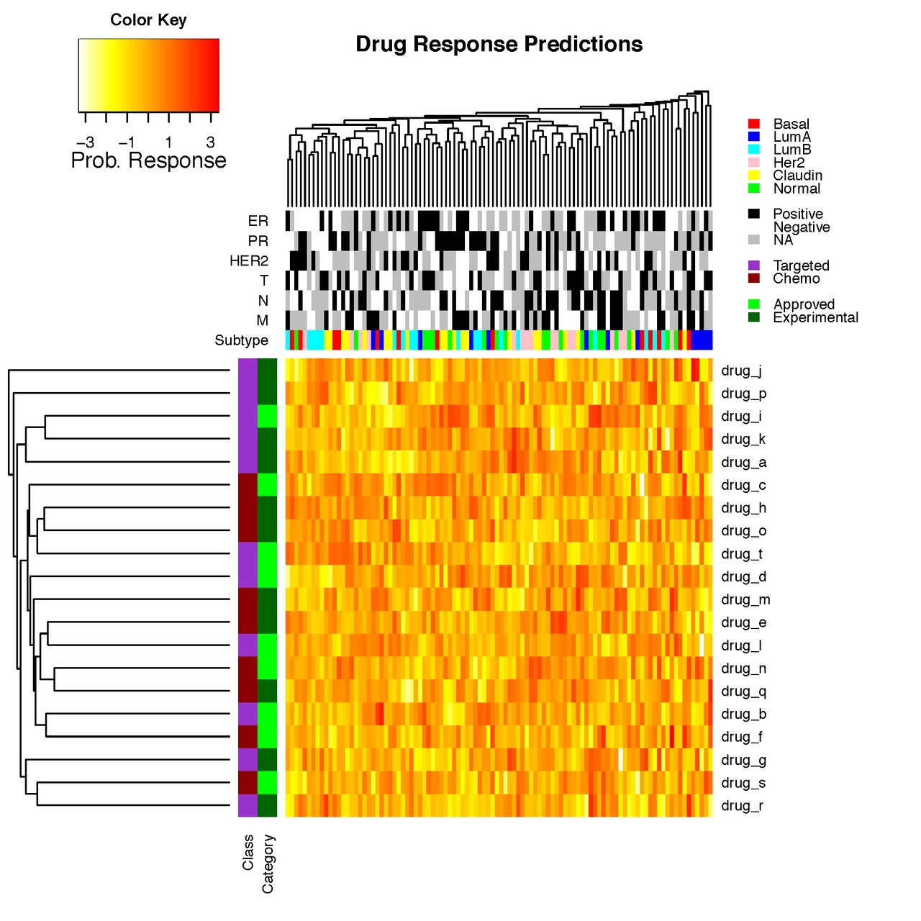
Heatmaps are a common way to simultaneously visualize multiple features of a dataset

Slide 26
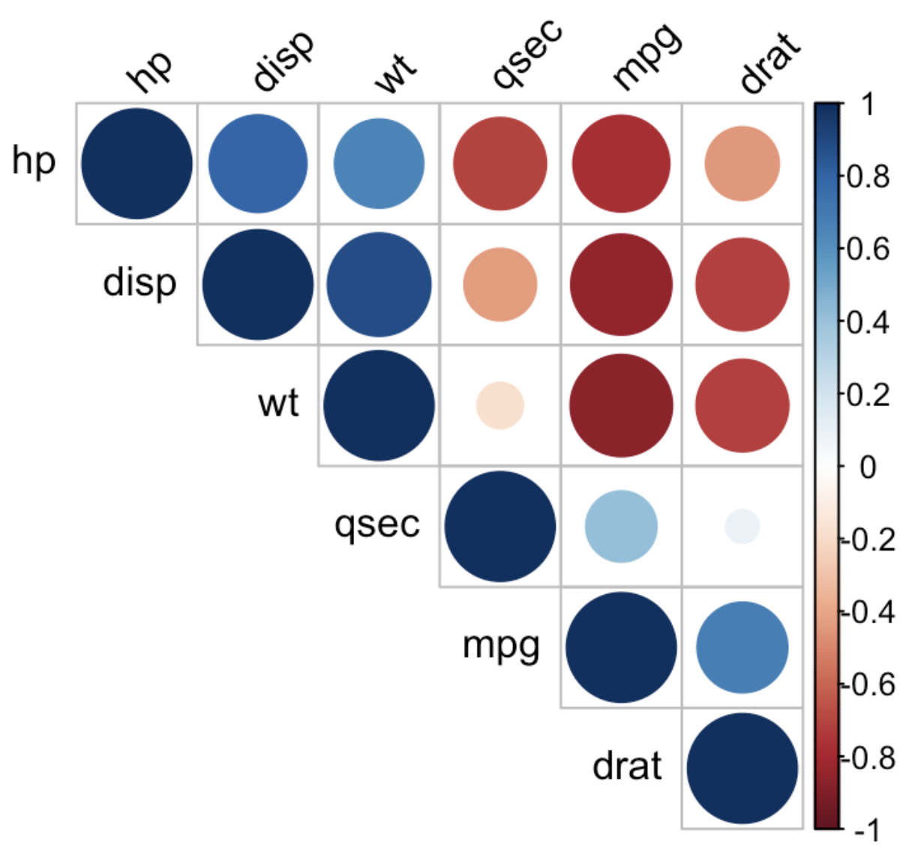
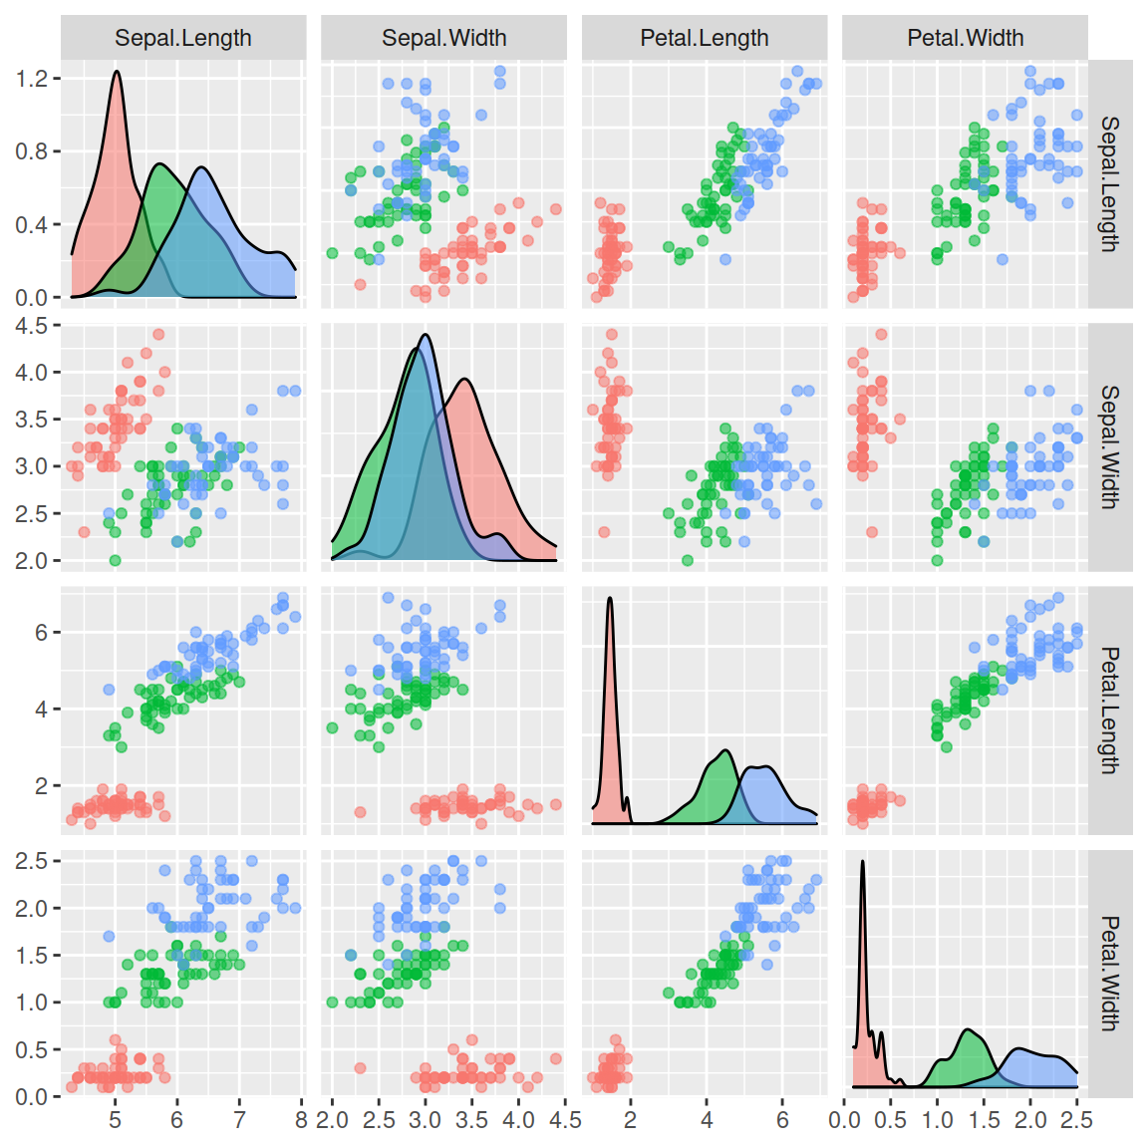
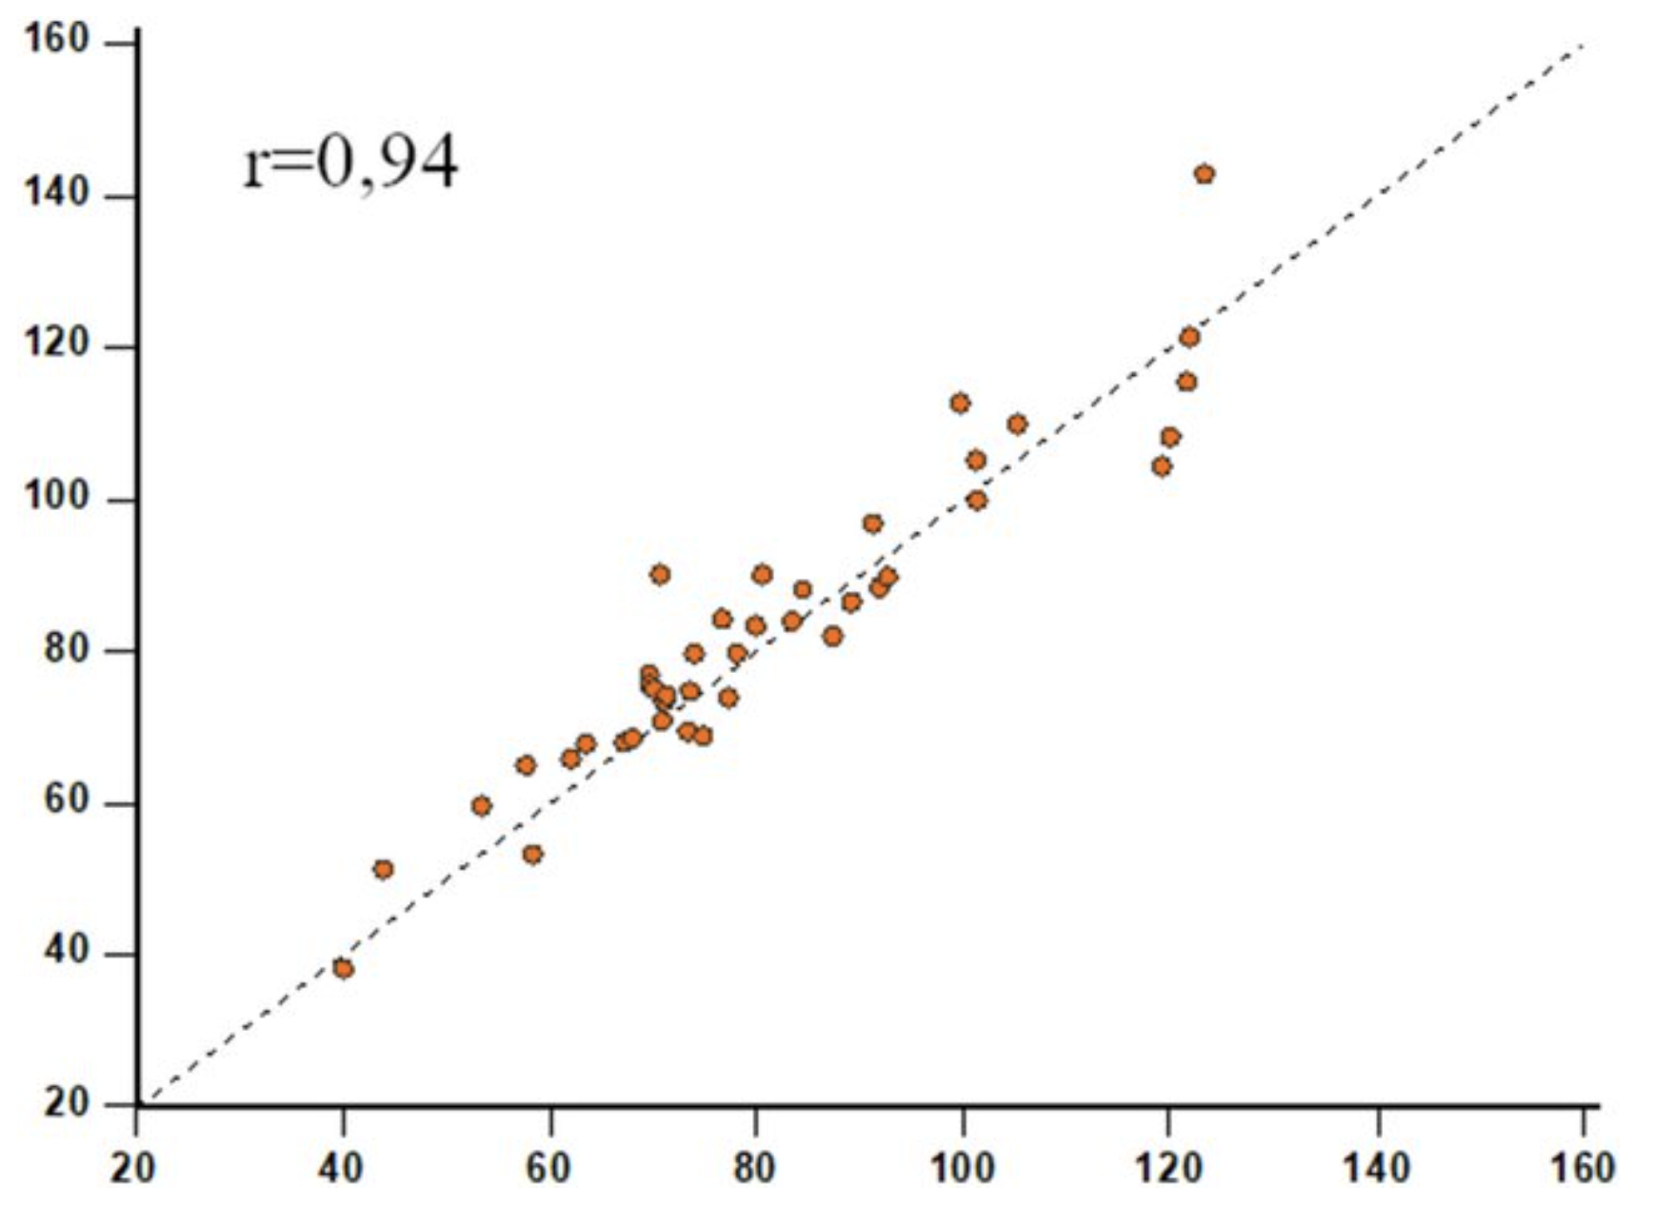
Dimensionality reduction
“Dimensionality reduction, is the transformation of data from a high-dimensional space into a low-dimensional space so that the low-dimensional representation retains some meaningful properties of the original data”
Common approaches: principal component analysis (PCA), linear discriminant analysis (LDA), canonical correlation analysis (CCA), or non-negative matrix factorization (NMF) techniques, clustering by K-nearest neighbors algorithm
Used when dealing with large numbers of observations or variables when simpler approaches become unwieldy

Slide 27
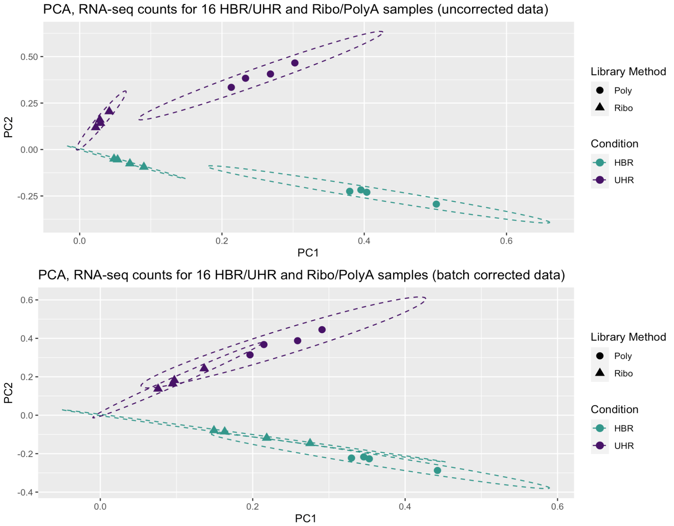
Dimensionality reduction (example 1 – RNA-seq batch effects)
Principal component analysis (PCA) approach to dimensionality reduction applied to 16 bulk RNA-seq data sets. Used to visualize batch effects and batch correction
https://rnabio.org/module-03-expression/0003/05/01/Batch-Correction/

Slide 28
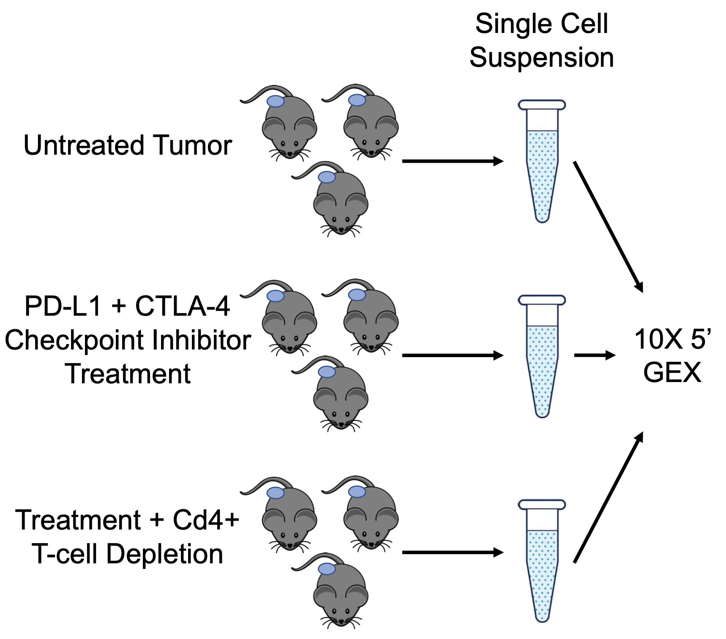
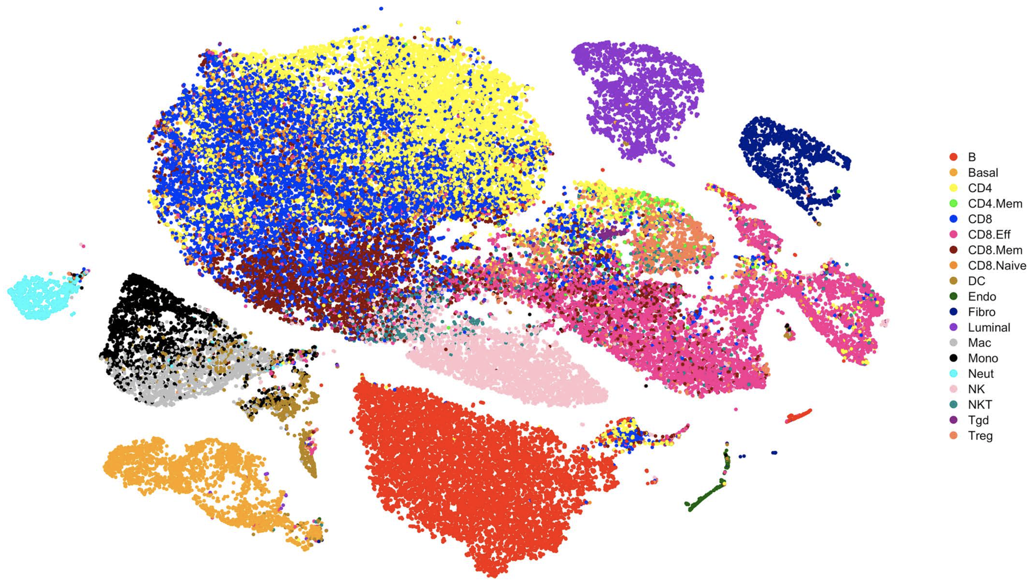
Dimensionality reduction (example 2 – single cell RNA)
t-SNE approach to dimensionality reduction applied to visualize gene expression patterns from >60,000 cells
5x
Sharon Freshour

Slide 29
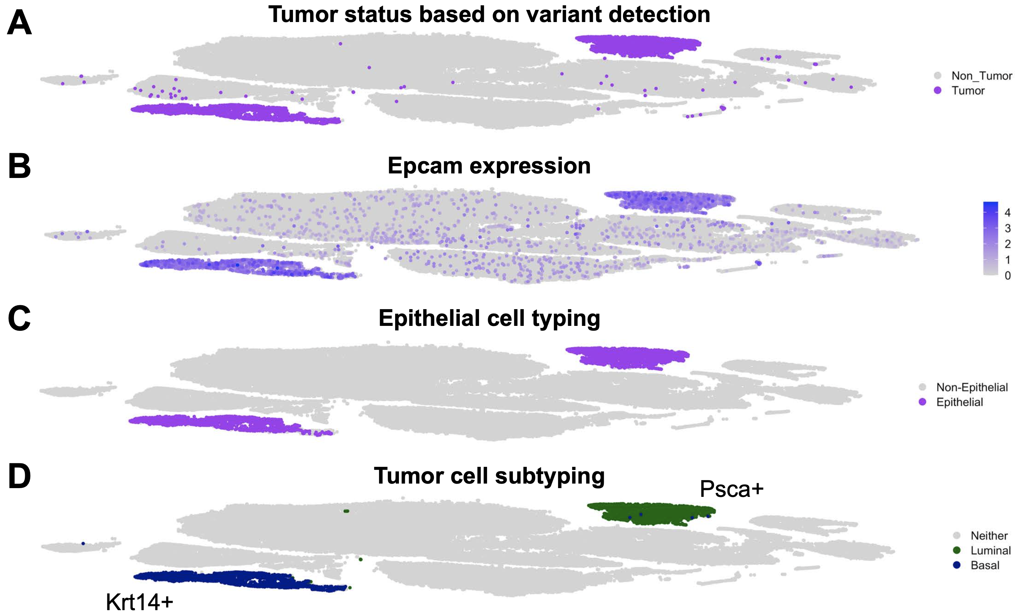
Dimensionality reduction (example 2 – single cell RNA)
Sharon Freshour

Slide 30
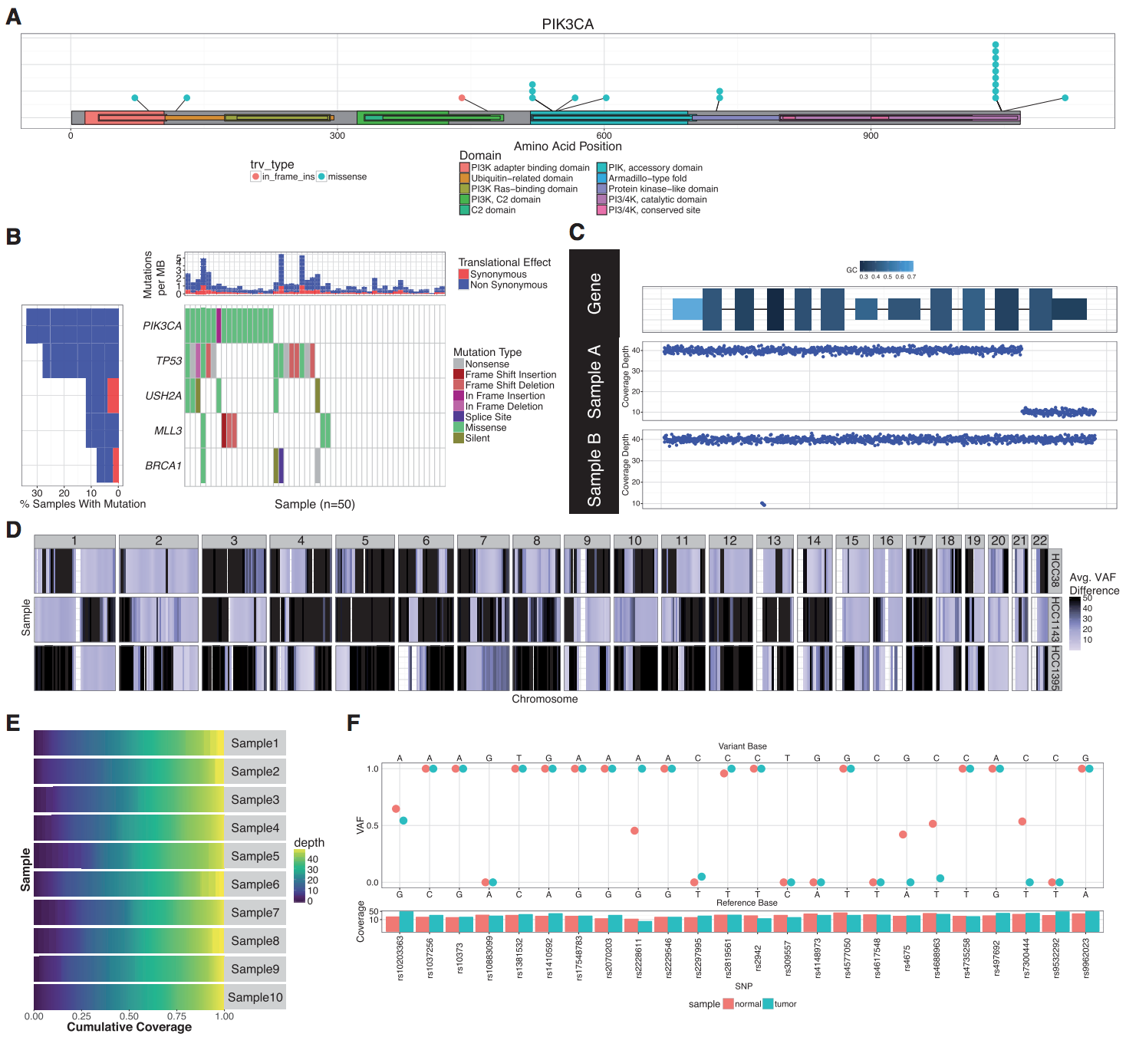
GenVisR and genviz.org online course were created to help others make common genomic visualizations

Slide 31
Introduction to GenViz course site
www.genviz.org

